Slide 1

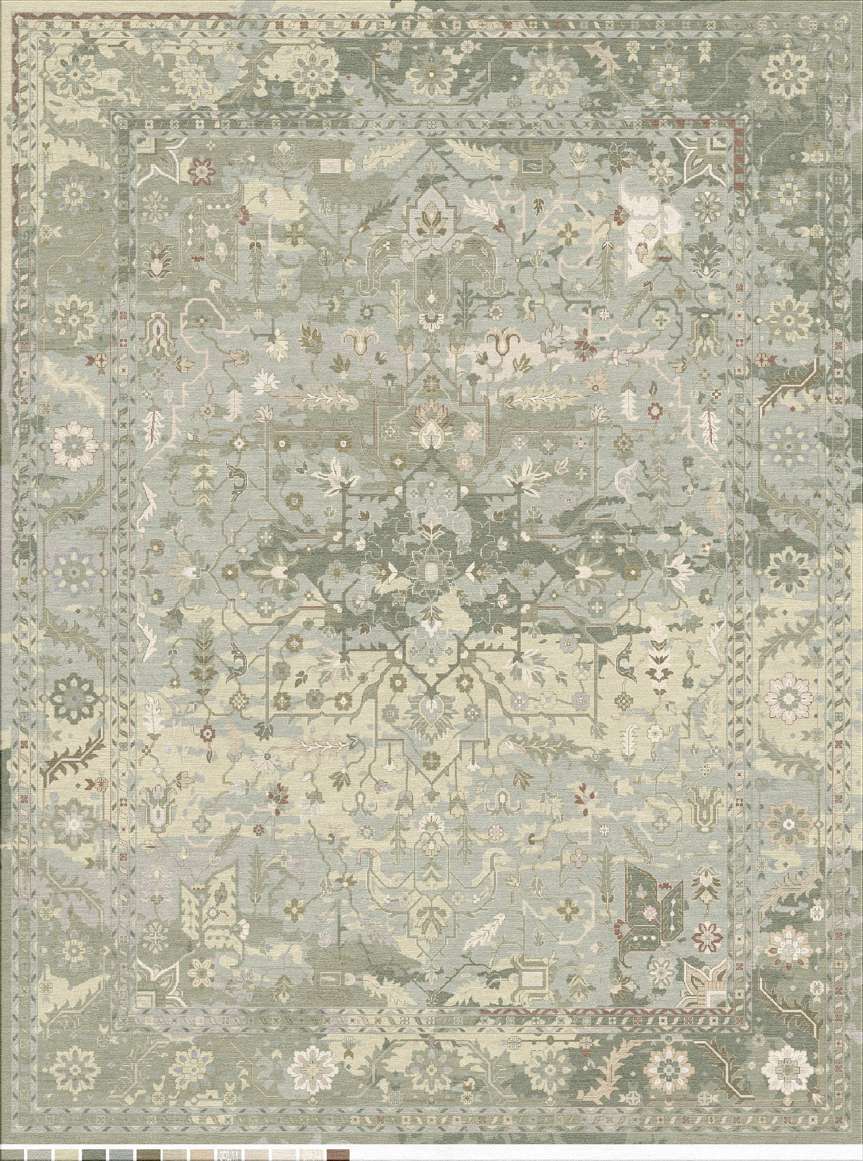
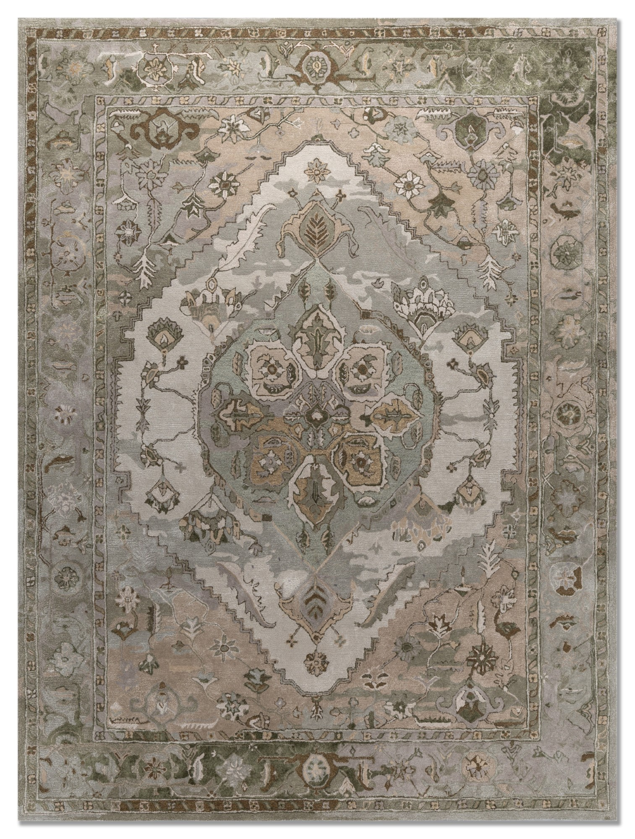
Date:
31/08/26
Construction:
Hand Tufted HD-14 pic
Project#:
PID-6815
Design:
DI765ss-CIT05-opt-01
Area:
^{#1:}
^{#2:}
^{#3:}
^{#4:}
^{#5:}
^{#6:}
^{#7:}
^{#8:}
^{#9:}
^{#10:}
^{#11:}
Length :19
^{#12:}
^{#10:}
^{SIZE :}
^{SHAPE :}
^{RUG QUALITY :}
^{FIBRE CONTENT :}
^{DYEING TECHNIQUE :}
^{FINISH EDGE :}
^{FINISH PILE HEIGHT :}
^{FINISH PILE TYPE :}
^{FINISH BACKING :}
^{FINISH WASH :}
^{14 ft X 19 ft}
^{RCT}
^{Hand Tufted HD}
^{Wool Viscose}
^{Standard}
^{4 side binding}
^{Standard pile}
^{Cut pile}
^{XN backing}
^{Standard}
Width : 14 ft
^{APPROVAL BOX:}
Notes:
Approved By: __________________________
*IMPORTANT: Before approving a render, always consult accrual yarns to ensure color precision.
Date: __________________________
Jaipur Living - 1800 Cherokee Pkwy, Acworth, GA 30102 - jaipurliving.com

Slide 2
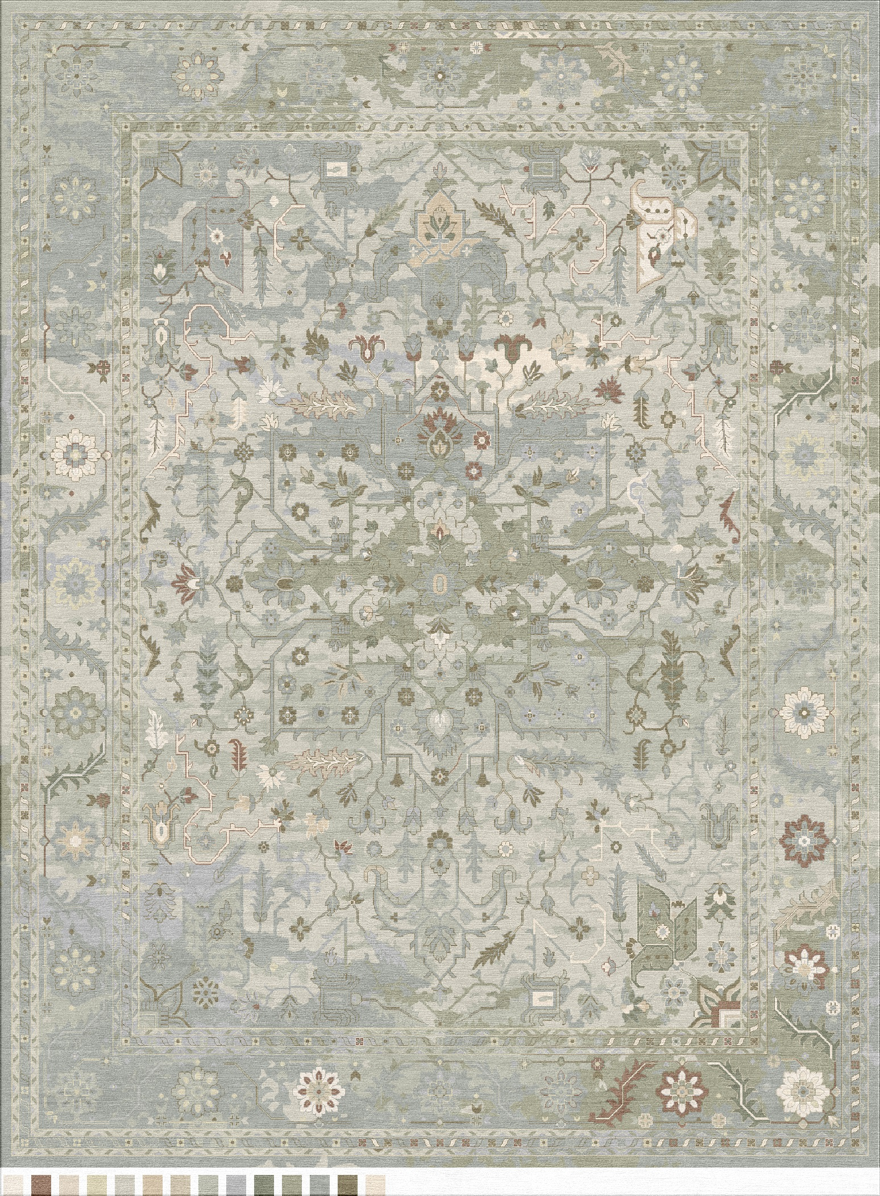
Date:
31/08/26
Construction:
Hand Tufted HD-14 pic
Project#:
PID-6815
Design:
DI765ss-CIT05-opt-01
Area:
^{#1:}
^{#2:}
^{#3:}
^{#4:}
^{#5:}
^{#6:}
^{#7:}
^{#8:}
^{#9:}
^{#10:}
^{#11:}
Length :19
^{#12:}
^{#10:}
^{SIZE :}
^{SHAPE :}
^{RUG QUALITY :}
^{FIBRE CONTENT :}
^{DYEING TECHNIQUE :}
^{FINISH EDGE :}
^{FINISH PILE HEIGHT :}
^{FINISH PILE TYPE :}
^{FINISH BACKING :}
^{FINISH WASH :}
^{14 ft X 19 ft}
^{RCT}
^{Hand Tufted HD}
^{Wool Viscose}
^{Standard}
^{4 side binding}
^{Standard pile}
^{Cut pile}
^{XN backing}
^{Standard}
Width : 14 ft
^{APPROVAL BOX:}
Notes:
Approved By: __________________________
*IMPORTANT: Before approving a render, always consult accrual yarns to ensure color precision.
Date: __________________________
Jaipur Living - 1800 Cherokee Pkwy, Acworth, GA 30102 - jaipurliving.com

Slide 3
Date:
31/08/26
Construction:
Hand Tufted HD-14 pic
Project#:
PID-6815
Design:
DI765ss-CIT05-opt-01
Area:
^{#1:}
^{#2:}
^{#3:}
^{#4:}
^{#5:}
^{#6:}
^{#7:}
^{#8:}
^{#9:}
^{#10:}
^{#11:}
Length :19
^{#12:}
^{#10:}
^{SIZE :}
^{SHAPE :}
^{RUG QUALITY :}
^{FIBRE CONTENT :}
^{DYEING TECHNIQUE :}
^{FINISH EDGE :}
^{FINISH PILE HEIGHT :}
^{FINISH PILE TYPE :}
^{FINISH BACKING :}
^{FINISH WASH :}
^{14 ft X 19 ft}
^{RCT}
^{Hand Tufted HD}
^{Wool Viscose}
^{Standard}
^{4 side binding}
^{Standard pile}
^{Cut pile}
^{XN backing}
^{Standard}
Width : 14 ft
^{APPROVAL BOX:}
Notes:
Approved By: __________________________
*IMPORTANT: Before approving a render, always consult accrual yarns to ensure color precision.
Date: __________________________
Jaipur Living - 1800 Cherokee Pkwy, Acworth, GA 30102 - jaipurliving.com

Slide 4
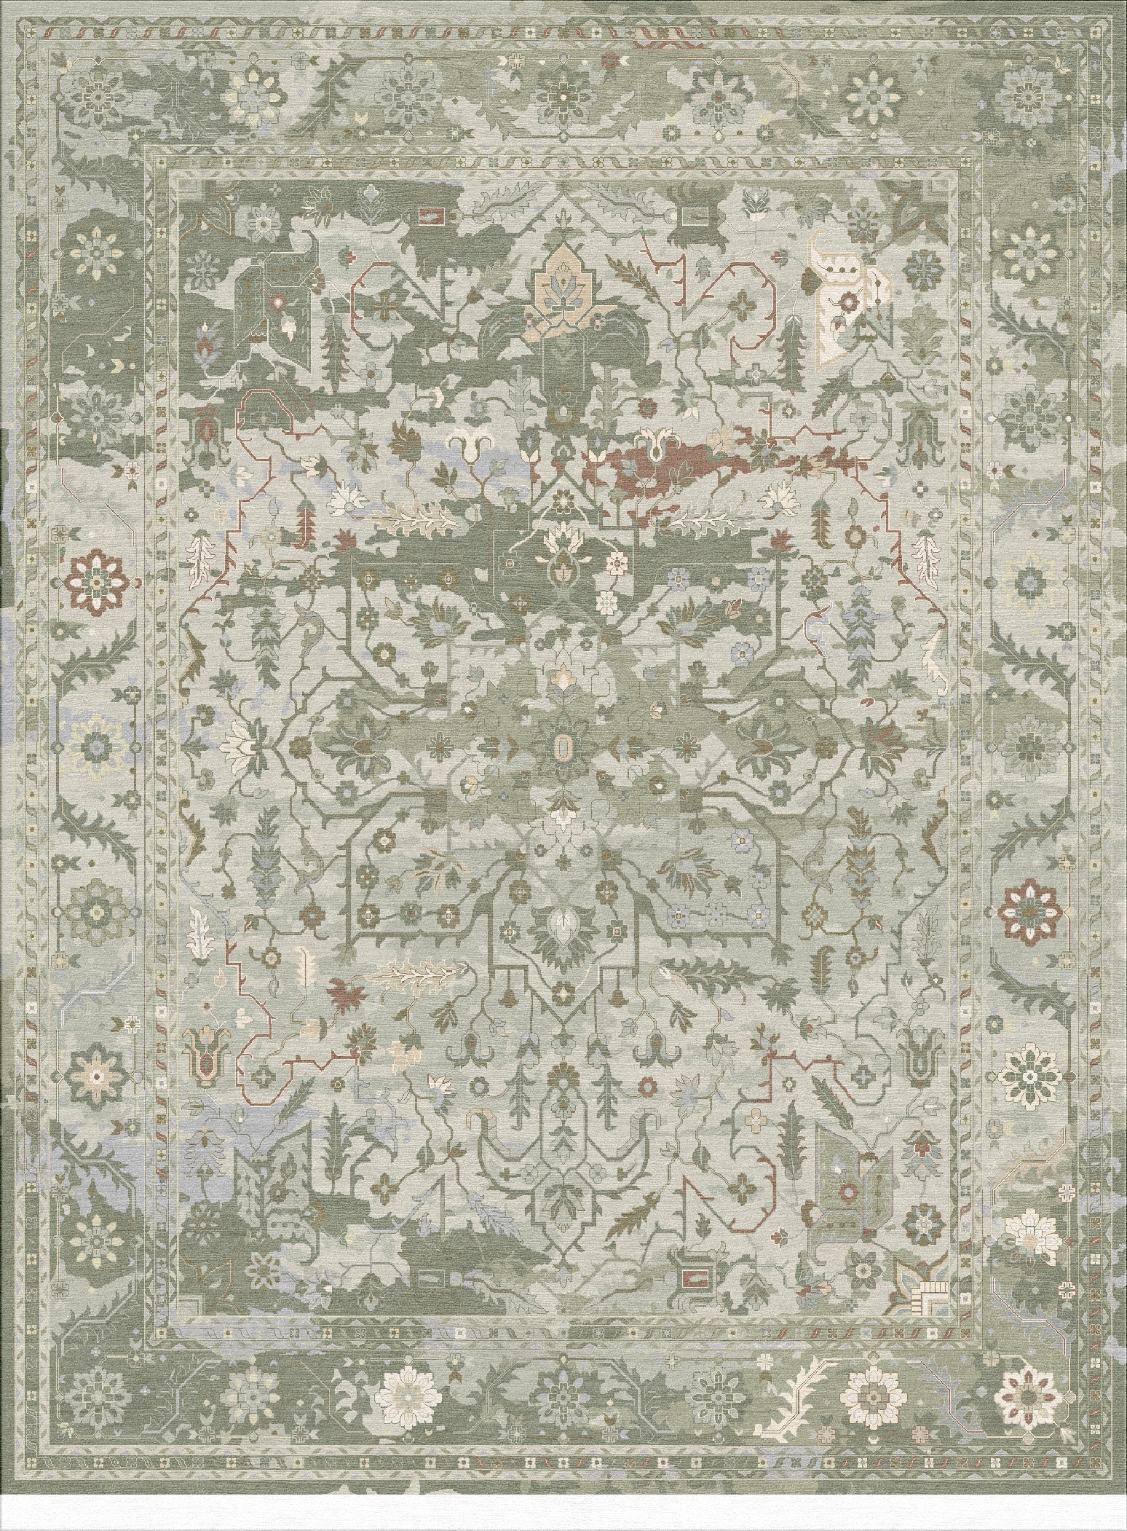
Date:
31/08/26
Construction:
Hand Tufted HD-14 pic
Project#:
PID-6815
Design:
DI765ss-CIT05-opt-01
Area:
^{#1:}
^{#2:}
^{#3:}
^{#4:}
^{#5:}
^{#6:}
^{#7:}
^{#8:}
^{#9:}
^{#10:}
^{#11:}
Length :19
^{#12:}
^{#10:}
^{SIZE :}
^{SHAPE :}
^{RUG QUALITY :}
^{FIBRE CONTENT :}
^{DYEING TECHNIQUE :}
^{FINISH EDGE :}
^{FINISH PILE HEIGHT :}
^{FINISH PILE TYPE :}
^{FINISH BACKING :}
^{FINISH WASH :}
^{14 ft X 19 ft}
^{RCT}
^{Hand Tufted HD}
^{Wool Viscose}
^{Standard}
^{4 side binding}
^{Standard pile}
^{Cut pile}
^{XN backing}
^{Standard}
Width : 14 ft
^{APPROVAL BOX:}
Notes:
Approved By: __________________________
*IMPORTANT: Before approving a render, always consult accrual yarns to ensure color precision.
Date: __________________________
Jaipur Living - 1800 Cherokee Pkwy, Acworth, GA 30102 - jaipurliving.com

Slide 5
Policies:
A custom rug is by nature a unique product. Slight variations in color and size are normal and should be expected.
All custom rugs can have a variance of +/- 3 inches.
Colors on screen may vary from the actual product due to differences in screen calibration and settings.
No changes may be made once order is placed.
No cancellations once items are in production.
You may cancel your custom rug order within 5 business days from the date of the order without penalty. If you wish to cancel standard customs after 5 business days, your deposit will be forfeited.
No returns/refunds of Custom Rug.
Size limitations vary between collections.
Production times are an estimate. All efforts will be made to produce in the time quoted.
Final delivery of your custom rug will vary based on size, construction and shipping method.
Jaipur Living - 1800 Cherokee Pkwy, Acworth, GA 30102 - jaipurliving.com

